Slide 1





Writing
Reading
Listening
Discuss
SET for Learning

Slide 2
LESSON

Slide 3
Stuck? Why not try…
Challenge:
LO: To consider how relationships are established through poetic features and language
SC:
We will consider what makes a poem, a poem.
We will identify the ways in which a relationship is presented in a song
We will analyse the presentation of this relationship

Slide 4
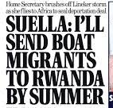
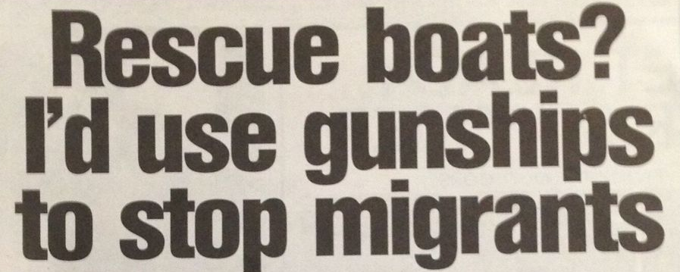

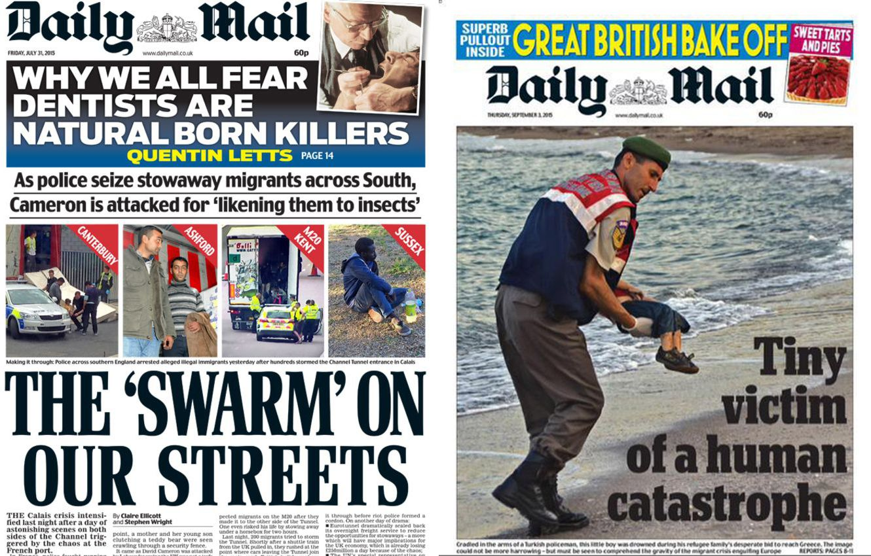
SET FOR LEARNING
Title: Poetry theme – ‘Refuge’
Look at the images below, of headlines from UK newspapers.
What can you learn and observe from this?

Slide 5
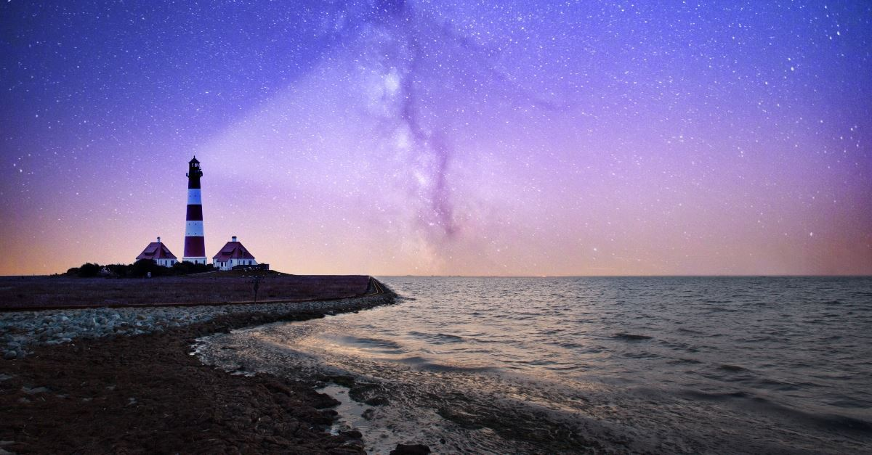
National Poetry Day theme – ‘Refuge’

Slide 6
Consider how poetry can relay emotional experiences and the importance of this
We will look into the idea of ‘refuge’ and what this means
We will begin creating our own poetry around this theme
We will look at some poetry about this theme and discuss its power

Slide 7
SET FOR LEARNING - Feedback
Title: Poetry theme – ‘Refuge’
Look at the images below, of headlines from UK newspapers.
What can you learn and observe from this?

Slide 8
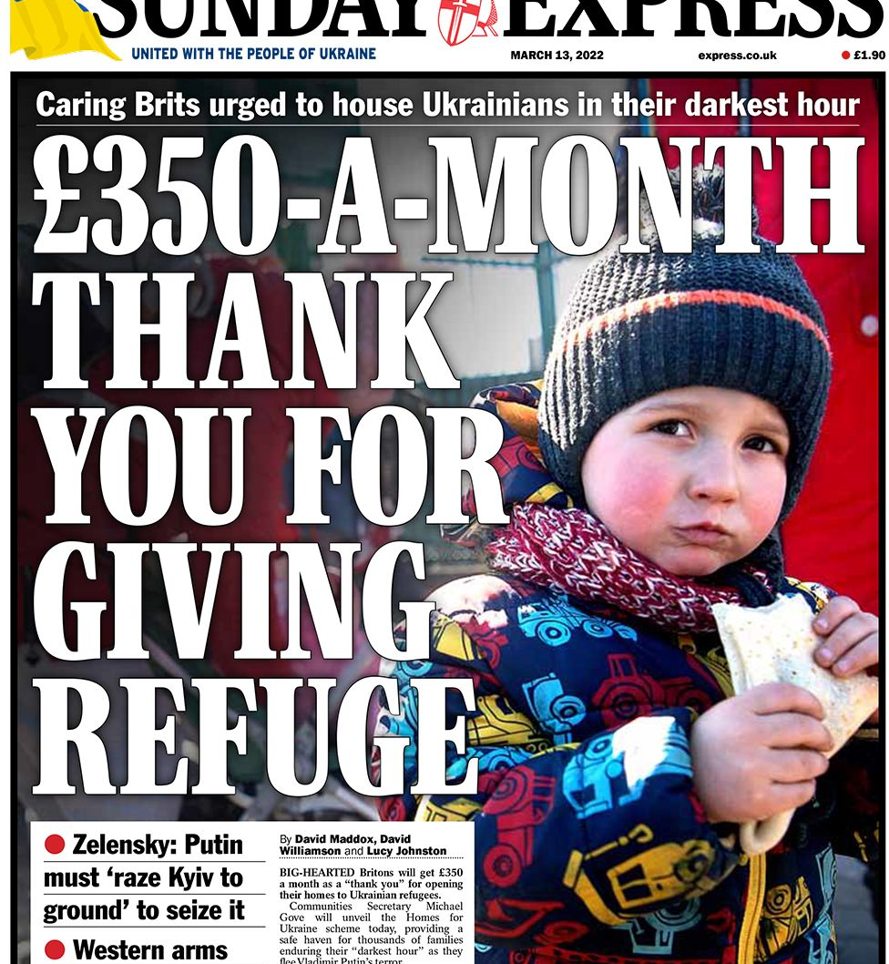
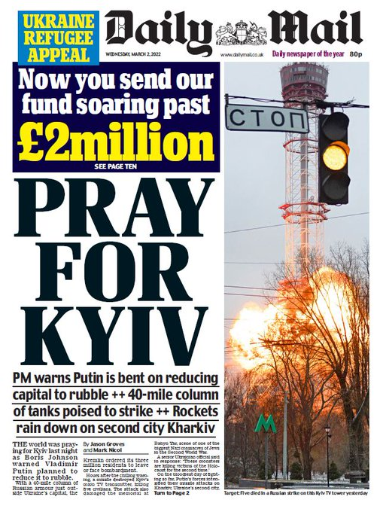
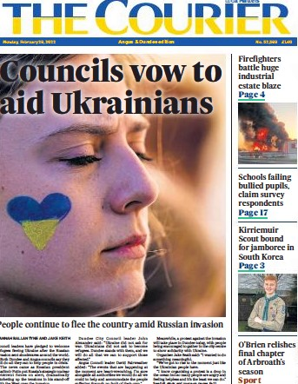
What is similar/different about these headlines?

Slide 9

Why is the wording and message different?

Slide 10
HOW DO WE MAKE CHANGE????
Why is the wording and message different?

Slide 11
‘Refuge’
What is ‘refuge’?
Definition: The state of being safe or sheltered from pursuit, danger, or difficulty or a place or situation providing safety or shelter.
What examples of refuge can you can come up with?
Write your ideas down.

Slide 12
Context of ‘Refuge’
Refuge can mean shelter or safety, but it is often used in relation to the term ‘refugee’.
Refugees are people who are fleeing war, conflict or other dangerous situations. They escape to safe countries/places to save their lives and the lives of people they love.
Watch this video to find out more https://www.youtube.com/watch?v=25bwiSikRsI

Slide 13
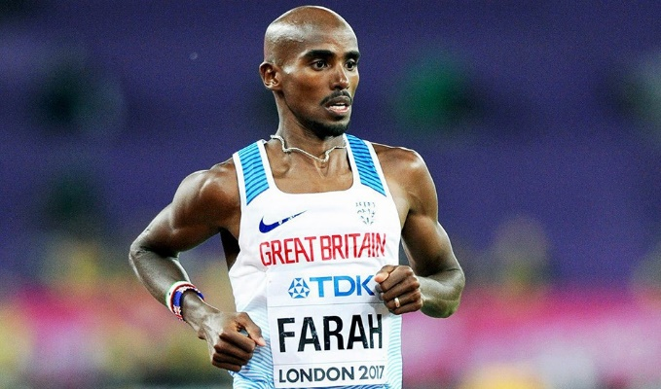
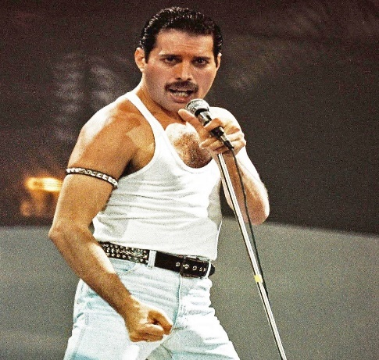
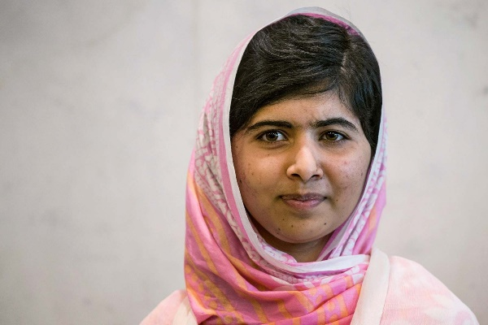
Using our voice
Below are pictures of people that have been refugees, asylum seekers or second generation immigrants.
Who are they? What have they done that has made a difference?

Slide 14
Freddie Mercury
Freddie spent much of his childhood back in India with relatives and was sent to British-style boarding school St Peter's in Panchgani near Bombay when he was eight. The family eventually emigrated to England in 1964, escaping the violent revolution in Zanzibar.
Freddie went on to lead the famous band 'Queen' with such classics as Bohemian Rhapsody. His parents were unsupportive for most of his career, especially when Freddie came out as bisexual.
His music has often been described as an escape for people who did not feel they fitted in or were isolated. He used many Arabic phrases in his songs like "Bismillah". This gave representation to Arabic folks in the music industry, whilst Freddie spoke out and advocated for safe spaces.
Freddie died of AIDS in 1991.

Slide 15
Malala
Malala was an outspoken education activist in Pakistan, when she was shot in the head at 15 years old.
She was granted asylum in the UK and was treated for her injuries and has stayed here since, completing her degree and education.
She continues to advocate for young women and their right to education. She was awarded a Nobel Peace Prize in 2014 and has written a book about her experiences called 'I am Malala'.
You can watch her speak here: https://www.youtube.com/watch?v=5SClmL43dTo

Slide 16
Mo Farah
Sir Mo Farah was brought to the UK illegally as a child and forced to work as a domestic servant.
He is known for his many Olympic Medals as a long distance runner. He was also Knighted by the Queen for his services to the sport.
He only revealed his traumatic refugee experience a few years ago and has since made a documentary about his experience, sharing the reality of the refugee crisis as it stands today.

Slide 17
Songs about ‘Refuge’
Are songs and poems the same thing? Why/why not?
Listen to these songs or raps. What are they saying about ‘Refuge’?
Aliens by Coldplay https://www.youtube.com/watch?v=we-LaiQNY5s
What is the message of this
song?

Slide 18
‘We Refugees’ by Benjamin Zephaniah
You have a copy of this poem in front of you.
You are going to read this poem as a class.
What is the message of this poem?

Slide 19
‘We Refugees’ by Benjamin Zephaniah - Discussion
Benjamin Zephaniah is not a refugee. But he was born to refugees.
Why is it, that a lot of activisim comes from the second generation, and not the first generation?
Can we write about topics such as ‘refuge’ if we haven’t experienced it?
Have a discussion with the person next to you about the above questions.

Slide 20
‘We Refugees’ by Benjamin Zephaniah - Discussion
Benjamin Zephaniah is not a refugee. But he was born to refugees.
Why is it, that a lot of activisim comes from the second generation, and not the first generation?
“Most of the literature on the children of migrants born in Europe or the US argues that the economic, social and political lives of second-generation individuals are different to those of their peers with no migratory background and to those of their migrant parents.”
(Chimienti, M., Bloch, A., Ossipow, L. et al. Second generation from refugee backgrounds in Europe.)

Slide 21
‘We Refugees’ by Benjamin Zephaniah - Discussion
Benjamin Zephaniah is not a refugee. But he was born to refugees.
Can we write about topics such as ‘refuge’ if we haven’t experienced it?
“We can all be refugees
Sometimes it only takes a day,
Sometimes it only takes a handshake
Or a paper that is signed.
We all came from refugees
Nobody simply just appeared,
Nobody’s here without a struggle,
And why should we live in fear
Of the weather or the troubles?
We all came here from somewhere.”

Slide 22
The Details
Your challenge is to write a poem OR lyrics to a song or rap, about the theme of ‘Refuge’, using some of the ideas and prompts from this lesson.
You have until ............
Any entries should be handed to your class teacher by …...
Those selected by an expert panel will be published!
Further information can be found at: https://www.firstnotemusictrust.com/npd2023-refuge-resources

Slide 23
Writing
Around the room, are 3 different images to do with 'Refuge'.
Get up and look at all of them.
You need to pick 3 adjectives to describe the picture.

Slide 24
Writing
Around the room, are 3 different images to do with 'Refuge'.
Now you have picked some adjectives to start with, you have this time to write your poem or song lyrics.
NOTE: If you do not finish now, and you want to enter, you can finish at home or in your own time.

